Slide 1

Department of Cyber Security
2026-2027- Odd Semester
III Year /V Sem
CS23533-FOUNDATIONS OF ARTIFICIAL INTELLIGENCE
Review 1– 25.09.2026

Slide 2
Introduction
2
During emergencies such as floods and road blockages, finding a safe evacuation route quickly is challenging.
This project uses OpenStreetMap road data to represent the real road network of Chennai.
The system applies the A* Search Algorithm to find a suitable route between selected locations.
When a road is marked as blocked or hazardous, the system avoids that road and generates an alternate safe route.
A web-based map interface allows users to select locations, view hazards, and visualize the evacuation route.
[Department] | Project Review – 1 | [Academic Year]

Slide 3
Problem Statement
3
During emergencies such as floods and road blockages, normal routes may become unsafe or unavailable.
Existing navigation systems may not specifically consider emergency hazards while selecting evacuation routes.
Finding a safe alternate route manually can be time-consuming and difficult during emergencies.
Therefore, there is a need for a system that can detect hazardous roads and automatically generate a safe alternate evacuation route using real road-network data.
[Department] | Project Review – 1 | [Academic Year]

Slide 4
Motivation
4
Natural disasters such as floods and road blockages can make regular routes unsafe.
During emergencies, people need to reach safe locations quickly and efficiently.
Manually searching for alternate routes can cause delay and confusion.
This motivated us to develop a system that can automatically detect hazardous roads and find a safe alternate route.
The project aims to support faster and safer emergency evacuation using A* Search and real road-network data.
[Department] | Project Review – 1 | [Academic Year]

Slide 5
Objectives
5
✓ To develop an AI-powered emergency evacuation route planning system for Chennai.
✓ To use OpenStreetMap road-network data to represent real-world roads as a graph.
✓ To implement the A* Search Algorithm for efficient route planning between selected locations.
✓ To identify and avoid blocked, flooded, and hazardous road segments during route calculation.
✓ To automatically generate a safe alternate route when the original route becomes unsafe.
✓ To provide an interactive map-based interface for selecting locations and visualizing evacuation routes.
[Department] | Project Review – 1 | [Academic Year]

Slide 6
Literature Survey
6
S.No. | Author & Year | Method / Technique | Key Findings | Limitations
1 | Alexandros Gaitanias et al., 2023 | Floor-plan graph generation + Dijkstra's Algorithm | Finds the shortest evacuation path using a graph-based floor plan. | Mainly focuses on shortest path; less suitable for changing emergency conditions.
2 | Ping Huang et al., 2024 | Multi-Criteria Decision Making | Selects suitable evacuation routes by considering multiple emergency factors. | More complex decision-making and may require more input information.
3 | Various Authors, 2023 | Intelligent Route Planning | Provides adaptable routes to support safe emergency evacuation. | May have limited dynamic route recalculation for newly blocked roads.
[Department] | Project Review – 1 | [Academic Year]

Slide 7
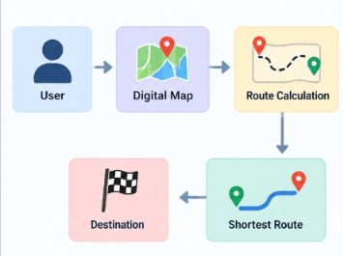
Existing System
7
Existing Approach:
Uses normal map-based route planning.
Provides the shortest route to the destination.
Technologies / Algorithms:
GPS
Digital Maps
Dijkstra / shortest-path algorithms
Advantages:
Easy to use
Fast route calculation
Easily available
Limitations:
Cannot handle sudden road blocks effectively.
Does not dynamically avoid flooded/hazardous roads.
Route may become unsafe during emergencies.
[Existing System Diagram / Screenshot]
[Department] | Project Review – 1 | [Academic Year]

Slide 8
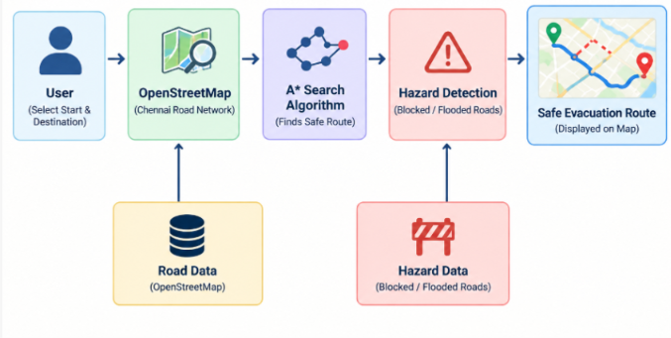
Proposed System
8
Proposed Approach
Uses A* Search Algorithm.
Uses OpenStreetMap for Chennai roads.
Avoids blocked and flooded roads.
Key Features
Hazard detection
Safe alternate route
Interactive map
Emergency route planning
Improvement
Avoids unsafe roads.
Finds an alternate route automatically.
Provides route visually on the map.
Expected Outcome
Safe evacuation route
Faster route planning
Reduced risk during emergencies
[Proposed System Diagram]
[Department] | Project Review – 1 | [Academic Year]

Slide 9
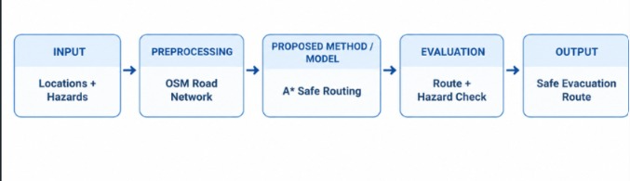
System Architecture / Block Diagram
9
The system takes the selected locations and hazard information as input. The Chennai road network is obtained from OpenStreetMap and the locations are mapped to road nodes. The A* Search Algorithm then calculates a safe route while avoiding hazardous roads. Finally, the selected safe evacuation route is displayed on an interactive map.
[Department] | Project Review – 1 | [Academic Year]

Slide 10
Methodology
10
1.Chennai road network, selected locations, hazard data.
2. Road network preparation and location-to-node mapping.
3. Road nodes, road distances, and hazard information
4. A* Search Algorithm with hazard avoidance.
5. Route distance, number of nodes, and safe route availability.
6. Safe evacuation route displayed on an interactive web map.
[Department] | Project Review – 1 | [Academic Year]

Slide 11
Technologies Used
11
Programming Language: Python
Framework / Library: Flask, OSMnx, NetworkX, Leaflet
Database: CSV Files
Tools / IDE: VS Code, PowerShell
Hardware: Laptop/Desktop with Internet Connection
AI Technique: A* (A-Star) Search Algorithm
Map Data: OpenStreetMap
Routing: Safe alternate route planning
Hazard Handling: Blocked and flooded roads
[Department] | Project Review – 1 | [Academic Year]

Slide 12
Module Description
12
Module 1-OSM Road Network & Location Handling
Module 2-A*Route Planning
Module 3 – Hazard Detection & Rerouting
Module 4 – Map Visualization & Web Server
Module 5 – Emergency Route Output & Evaluation
[Department] | Project Review – 1 | [Academic Year]

Slide 13
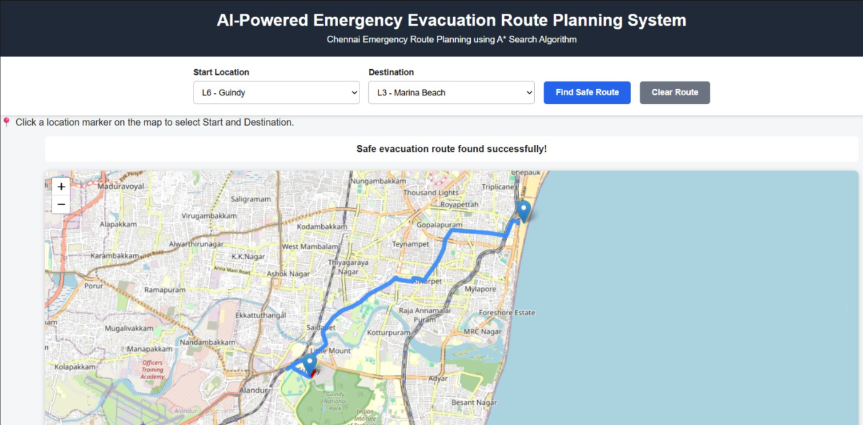
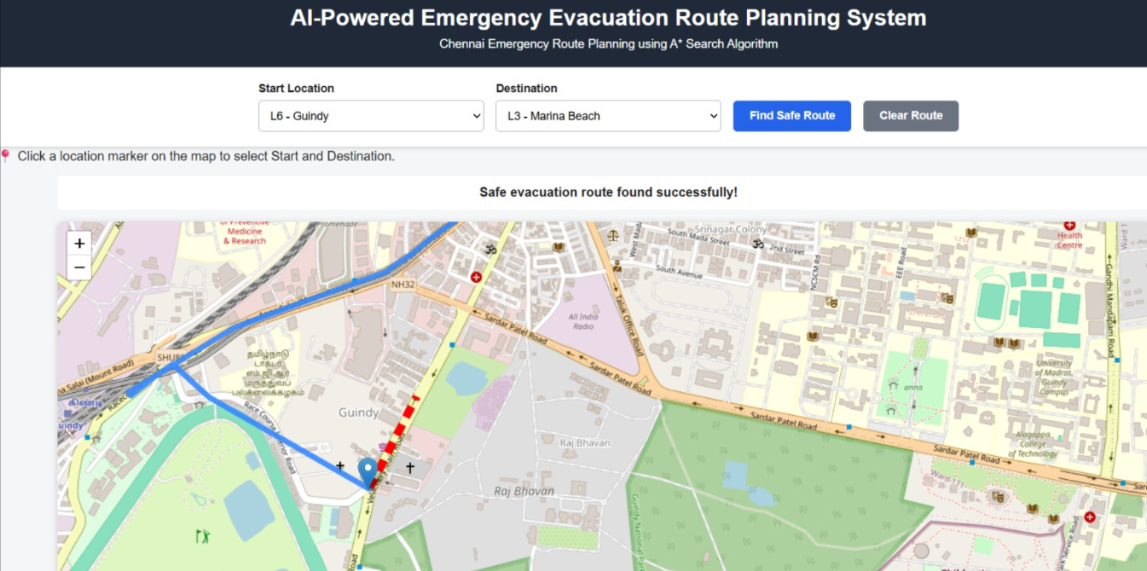
Preliminary / Expected Results
13
[Insert Graph / Chart]
[Insert Screenshot / Table]
[Department] | Project Review – 1 | [Academic Year]

Slide 14
Project Schedule
14
Activity | Month 1 | Month 2 | Month 3 | Month 4
Literature Survey | [✓ ] | [✓ ]
Problem Identification | [✓ ]
System Design |  | [✓ ]
Implementation |  | [✓ / ] | [✓ / ]
Testing & Evaluation |  |  | [✓ / ] | [✓ / ]
[Department] | Project Review – 1 | [Academic Year]

Slide 15
Current Progress
15
✓ Literature survey and existing system study completed
✓ Problem identification and requirement analysis completed
✓ OSM-based Chennai road network successfully created
✓ Module 1 – OSM Road Network & Location Handling completed
✓ Module 2 – A* Route Planning completed
✓ Module 3 – Hazard Detection & Rerouting completed
✓ Blocked and flooded road scenarios tested
✓ Alternate safe route generation successfully verified
✓ Initial system testing completed
[Department] | Project Review – 1 | [Academic Year]

Slide 16
Future Work
16
☐ Complete Module 4 – Map Visualization & Web Server
☐ Integrate route, location and hazard information into the interactive map
☐ Complete Module 5 – Emergency Route Output & Evaluation
☐ Display final evacuation route details and route information
☐ Test the system with different source, destination and hazard scenarios
☐ Evaluate the effectiveness of alternate route generation
☐ Prepare final documentation and live demonstration
[Department] | Project Review – 1 | [Academic Year]

Slide 17
Conclusion
17
The proposed system successfully combines OpenStreetMap road data and the A* Search Algorithm to plan emergency evacuation routes. It maps selected locations to the road network and calculates a suitable route between the source and destination.
The system also considers hazard information such as blocked roads and removes hazardous roads from the routing network. This allows the system to generate an alternate safe route when the normal route is affected.
Finally, the generated route is displayed through an interactive web map. Thus, the system provides a simple approach for visualizing safe evacuation routes during emergency situations.
[Department] | Project Review – 1 | [Academic Year]

Slide 18
References
18
[1] OpenStreetMap Foundation, “OpenStreetMap,” 2004.
https://www.openstreetmap.org/
[2] Boeing, G., “OSMnx: New Methods for Acquiring, Constructing, Analyzing, and Visualizing Complex Street Networks,” 2017.
https://osmnx.readthedocs.io/
[3] NetworkX Developers, “NetworkX Documentation,” 2005.
https://networkx.org/
[4] Python Software Foundation, “Python Documentation,” 1991.
https://docs.python.org/3/
[5] Pallets Projects, “Flask Documentation,” 2010.
https://flask.palletsprojects.com/
[6] Volodymyr Agafonkin, “Leaflet – JavaScript Library for Interactive Maps,” 2011.
https://leafletjs.com/
[7] P. E. Hart, N. J. Nilsson, and B. Raphael, “A Formal Basis for the Heuristic Determination of Minimum Cost Paths,” IEEE Transactions on Systems Science and Cybernetics, 1968.
[Department] | Project Review – 1 | [Academic Year]

